Slide 1

E-Commerce Store
Developed at
Instance It Solutions
Under The Guidance Of
Internal Guide
Prof. Faruk Abdulla
External Guide
Mr. Dhiren Jummanni
Developed By
Nanda Amit (2205112110060)
Submitted To:
Department of MCA
Faculty of IT & Computer Science,
PARUL University

Slide 2
1. Index
No. | Description | Page No.
1 | Project Profile | 3-12
2 | Requirement Analysis | 13-29

Slide 3
2. Project Profile
1. Project Definition:
Project definition refers to the initial phase of a project where the project objectives, scope, deliverables, and constraints are identified and documented. It essentially sets the foundation for the entire project. During this phase, key stakeholders come together to establish a clear understanding of what the project aims to achieve and how it will be executed.
2. Project Description:
Project description provides a detailed overview of the project, including its purpose, objectives, scope, and other relevant information. It serves as a comprehensive document that outlines what the project entails and how it will be executed.

Slide 4
2. Project Profile
3. Project Scope:
Develop an e-commerce platform specialized in sports goods and equipment to cater to athletes and sports enthusiasts.
Design and development of a user-friendly website with intuitive navigation.
Physical inventory management beyond the online platform.
Customization of products beyond standard options available through the website.
4. Key Features:
Key features are the functionalities and capabilities that make the e-commerce website unique and attractive to users.
Providing order tracking functionality to allow users to monitor the status of their orders.
Special features tailored to sports e-commerce, such as size guides, sales-specific categorization, etc.

Slide 5

2. Project Profile
5. Technology Stack:
Overview of the technologies to be used in the development process.
Frontend: HTML5, CSS3, JavaScript, Ajax, Boostrap
Backend: PHP
Database: MySql

Slide 6

2. Project Profile
6. Problem Statements:
Problem statements in an e-commerce website like Salesport typically revolve around addressing issues or challenges faced by users, administrators, or the system itself.
Users find it difficult to navigate through the website, leading to a high bounce rate and low conversion rates.

Slide 7

2. Project Profile
7. Needs for New System:
Identifying the needs for a new system in an e-commerce website like Salesport involves understanding the current shortcomings and envisioning improvements or additional features to address them.
Implementing a more intuitive and user-friendly interface to improve navigation, search functionality, and overall browsing experience for customers.

Slide 8
2. Project Profile
8. Proposed System:
The proposed system for Salesport e-commerce website aims to address the identified needs and overcome the existing challenges while leveraging opportunities for improvement.
Designing a modern, intuitive, and responsive user interface that prioritizes ease of navigation, accessibility, and aesthetics to enhance the overall user experience.
Developing a mobile-responsive website and dedicated mobile app to cater to users who prefer shopping on smartphones and tablets, ensuring a seamless and consistent experience across all devices.
Deploying an efficient order management system that automates order processing, streamlines fulfillment, provides real-time order tracking, and facilitates seamless communication between customers, suppliers, and logistics partners.

Slide 9

2. Project Profile
9. Outcomes:
The outcomes of developing a salesport e-commerce website can be multifaceted and beneficial to various stakeholders involved.
Customers will experience a more intuitive, responsive, and visually appealing website interface, leading to increased satisfaction and engagement.
Expanded payment options, personalized recommendations, and streamlined order processing will contribute to higher conversion rates and revenue growth.

Slide 10

2. Project Profile
10. Project Plan:
Creating a comprehensive project plan is crucial for the successful implementation of the Salesport e-commerce website.
Define project objectives, scope, and deliverables.
Identify key stakeholders and establish communication channels.
Conduct detailed analysis of current system shortcomings and user needs.

Slide 11
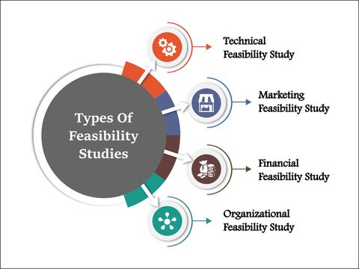
3. Requirement Analysis
11. Feasibility Study:
Technical Feasibility:
Assess the technical capabilities and expertise available within the organization or among project team members.
Market Fesibility:
Conduct market research to understand the competitive landscape, target audience, and market trends in the e-commerce industry.
Analyze consumer preferences, purchasing behavior, and demand for products/services offered by Salesport.

Slide 12
3. Requirement Analysis
11. Feasibility Study:
.Financial Feasibility:
Estimate the costs associated with developing, deploying, and maintaining the e-commerce website, including software development, infrastructure, licensing fees, and ongoing operational expenses.
Organizational Feasibility:
Develop a realistic project timeline with well-defined milestones, tasks, and dependencies.
Assess the feasibility of meeting project deadlines and deliverables within the allotted time frame.

Slide 13
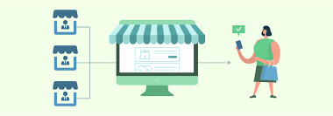
3. Requirement Analysis
12. Users of the System
1. Customers:
Customers are the primary users of the e-commerce website. They visit the platform to browse products, make purchases, and track orders.
Customers may create accounts to store their preferences, view order history, and receive personalized recommendations.
2. Administrators:
They have access to the back-end dashboard, where they can add, edit, or remove products, manage inventory, and update pricing and discounts.

Slide 14
3. Requirement Analysis
12. Users of the System
3. Customer Support Representatives:
Customer support representatives assist customers with inquiries, issues, and requests related to orders, products, payments, and account management.
They communicate with customers via live chat, email, or phone to provide assistance, resolve complaints, and ensure a positive shopping experience.

Slide 15
3. Requirement Analysis
12. Users of the System
4. Developers and IT Staff:
Developers and IT staff are responsible for building, maintaining, and updating the technical infrastructure of the e-commerce platform.
They handle tasks such as software development, database management, server maintenance, security updates, and performance optimization.
5. Analytics and Reporting Team:
The analytics and reporting team collects and analyzes data from the e-commerce platform to gain insights into user behavior, sales performance, and website metrics.

Slide 16
3. Requirement Analysis
13.Process & modules of the System:
User Registration and Authentication:
Process: Users can register for an account by providing basic information such as name, email address, and password. Upon registration, users undergo email verification or mobile verification for account activation.
Modules: User registration module, authentication module, verification module.
2. Product Management:
Process: Administrators can add, edit, or remove products from the platform. They can specify product details such as name, description, price, images, categories, and availability.
Modules: Product creation module, product editing module, product deletion module, category management module.

Slide 17
3. Requirement Analysis
13.Modules of the System:
3. Product Catalog:
Process: Customers can browse through the product catalog to view available items. They can filter products by category, price range, brand, or other attributes. Product listings display relevant information and images.
Modules: Product listing module, filtering and sorting module, search module.
4. Order Management:
Process: Administrators manage orders placed by customers. They can view order details, update order status (e.g., processing, shipped, delivered), generate invoices, and handle returns or cancellations.
Modules: Order listing module, order details module, order status update module, invoice generation module.

Slide 18
3. Requirement Analysis
13.Modules of the System:
5. User Account Management:
Process: Users can manage their accounts by updating personal information, changing passwords, and viewing order history. Administrators have access to user management tools for account verification, suspension, or deletion.
Modules: User profile module, account settings module, password change module, user listing module.
6. Search and Navigation:
Process: Users can search for products using keywords or browse through categories and subcategories. Advanced search features may include filters, sorting options, and predictive search suggestions.
Modules: Search bar module, search results module, navigation menu module, filtering options module.

Slide 19
3. Requirement Analysis
13.Modules of the System:
7. Customer Support:
Process: Customers can access customer support through various channels such as live chat, email, or phone. Customer support representatives manage inquiries, provide assistance, and resolve issues in a timely manner.
Modules: Live chat module, contact form module, ticketing system module, help center module.
8.User Experience Optimization:
Optimize the user experience of your e-commerce store to maximize conversions.
This involves streamlining the checkout process, improving site speed, and making navigation intuitive.

Slide 20
3. Requirement Analysis
13.Modules of the System:
9. Analytics and Reporting:
Process: The system collects and analyzes data to generate insights into user behavior, sales performance, and website metrics.
10. Content Management:
Process: Administrators manage website content such as static pages, blog posts, banners, and promotional offers. They can create, edit, or delete content to keep the website updated and engaging for users.
11. Security and Compliance:
Process: The e-commerce platform implements security measures to protect user data, prevent fraud, and ensure compliance with legal and regulatory requirements This includes encryption, secure authentication, regular audits, and data privacy policies.

Slide 21
3. Requirement Analysis
14. Hardware Requirement:
1. Database Server:
A robust database server to store product information, user data, order details, and other critical data.
Support for relational database management systems (RDBMS) such as MySQL, PostgreSQL, or MariaDB.
Consideration for scalability, data integrity, and performance optimization.
2. Storage:
Sufficient storage space to store product images, multimedia content, and other files associated with the e-commerce website.

Slide 22
3. Requirement Analysis
14. Hardware Requirement:
3. Load Balancer:
Helps prevent server overload and ensures optimal performance during peak periods.
Hardware load balancers or software-based solutions can be used depending on the requirements.
4. Networking Equipment:
High-speed internet connection with adequate bandwidth to support concurrent user access and data transfer.Networking equipment such as routers, switches, and firewalls to ensure network security, traffic management, and data protection.
5. Backup and Redundancy:
Implement backup systems and redundancy measures to minimize the risk of data loss and ensure high availability.

Slide 23
3. Requirement Analysis
14. Hardware Requirement:
6. Monitoring and Management Tools:
Utilize monitoring tools and software for real-time performance monitoring, server health checks, and system diagnostics.
Management tools for server administration, configuration management, and automated deployment.
7. Scalability and Expansion:
Plan for future scalability and expansion by selecting hardware components that can accommodate growth in user traffic, data volume, and system complexity.
Consider cloud-based infrastructure services for flexible scaling and on-demand resource provisioning.

Slide 24
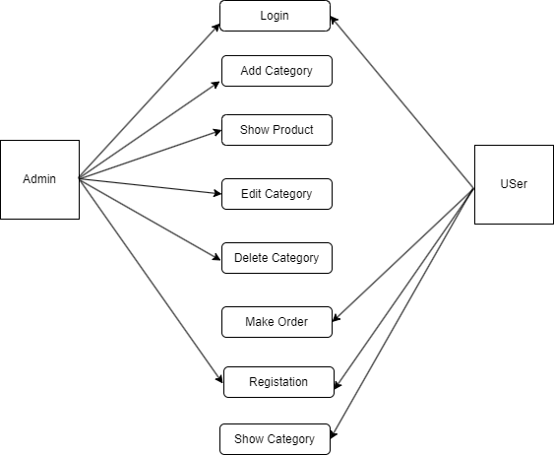
3. Requirement Analysis
15. Use case diagram
Use Case Diagram

Slide 25
Thank You

